Slide 1
Regression Analysis
Puneet Jindal, Data Scientist
Indian School of Business
Thapar University

Slide 2
What is Regression Analysis
Regression is a tool for finding a relationship between a Explained variable and one or more Explanatory variables in a study.
The relationship can be linear or non-linear.
Real estate example to physical characteristics of the building and taxes
Cigarette consumption to socioeconomic and demographic variables
Relationship expressed in the form of an equation or model connecting the response or dependent variable and one or more explanatory or predictor variables
How MRP affects the purchase decision?
Which promotion is more effective?
What is the risk associated with price increase on customer retention?
Which customer is likely to default?
What percentage of loans is likely to result in a loss?
How to identify the most profitable customer?

Slide 3
Applications of Regression Analysis
Agriculture - predicting current milk production
Industrial and Labor relations - Effects of labor laws amendments on cost of living
Government – predict domestic immigration
Environmental Sciences – relationship between water quality and land use
Industrial production – estimate the polishing time for new products to design
Sports– predict the chances of winning
History – predict age of historical objects
Psychology – Social media campaigning in elections

Slide 4
Sample Datasets
Data and Story Library(DSAL) is one of the most interesting sites which is contains lot of data files and stories
http://lib.stat.cmu.edu/DASL/
https://www.umass.edu/statdata/

Slide 5
Steps in Regression Analysis
Statement of the problem
Selection of potentially relevant variables
Data collection
Model specification
Choice of fitting method
Model fitting
Model Criticism and Selection - What are the required assumptions?
Using the chosen model for the solution of the posed problem

Slide 6
Classifications of Regression Analysis
Univariate/Multivariate - based on quantitative response variable
Simple/Multiple - based on predictor variables
Linear/Non-Linear – relationship type between dependent and independent variables
ANOVA/ANCOVA – all predictors are qualitative variables
Logistic – if the response variable is qualitative in nature
Poisson – if the response variable is positive integer i.e. count data

Slide 7
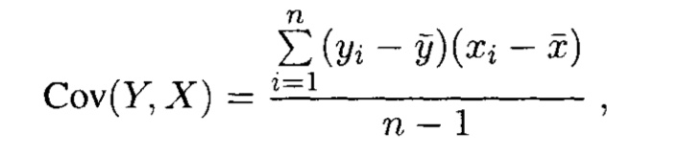
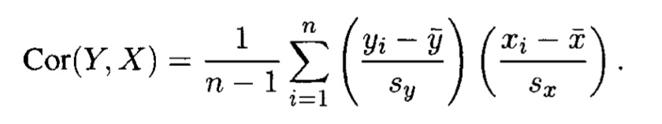
Covariance and Correlation Coefficient
Covariance is a measure of the degree to which two random variables (X, Y) change together. If the variables tend to show similar behavior, the covariance is positive. In the opposite case, when the greater values of one variable mainly correspond to the smaller values of the other, the covariance is negative.
While the correlation coefficient measures a degree to which two variables are related, it only measures the linear relationship between the variables. Nonlinear relationships between two variables cannot be captured or expressed by the correlation coefficient.

Slide 8
Comparison of correlation and covariance
Although both the correlation coefficient and the covariance are measures of linear association, they differ in the following ways:
Correlations coefficients are standardized. Thus, a perfect linear relationship results in a coefficient of 1.
Covariance values are not standardized. Thus, the value for a perfect linear relationship depends on the data.
The correlation coefficient is a function of the covariance. The correlation coefficient is equal to the covariance divided by the product of the standard deviations of the variables. Therefore, a positive covariance always results in a positive correlation and a negative covariance always results in a negative correlation.

Slide 9
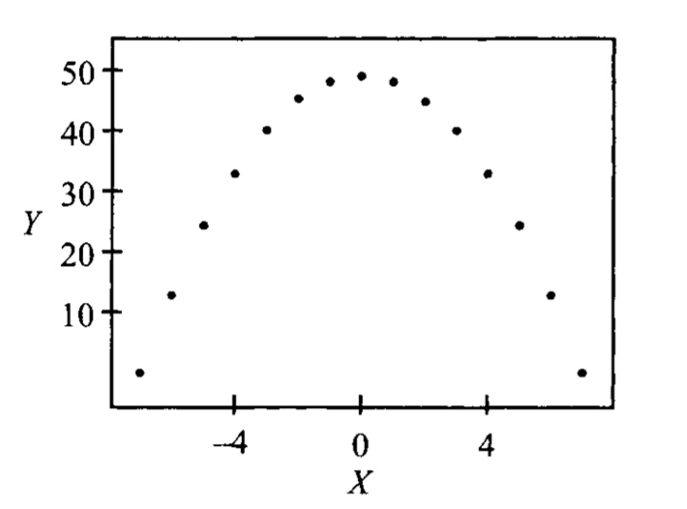
Non- Linear Correlation
Cor(X,Y) = 0 doesn’t mean that X and Y are not correlated. It just means that they are not related linearly

Slide 10
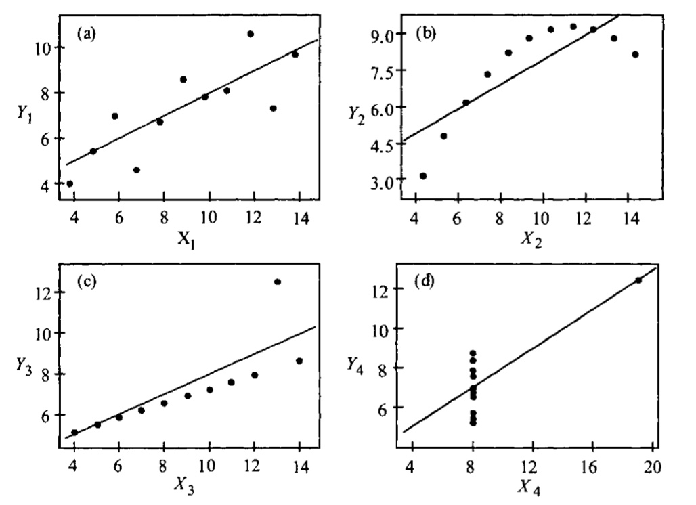
Anscombe Quartet
Correlation can be substantially influenced by one or few outliers in the data.
Figures presented on the right hand side. All these have same correlation in spite of their completely different distribution
This is a limitation of Correlation

Slide 11
Simple Linear Regression
Parameter Estimation with Least squares method
The least squares method is a form of mathematical regression analysis that finds the line of best fit for a dataset, providing a visual demonstration of the relationship between the data points. Each point of data is representative of the relationship between a known independent variable and an unknown dependent variable.
Model
Consider the following variables and parameters: Response or dependent variable = Y
Auxiliary or independent variable = X
Parameters = A, B
The response variable is linear with the parameters
Y = A+BX

Slide 12
Difference between Regression and Correlation Analysis
Cor. Is useful quantity for measuring the direction and strength of linear relationships.
It can’t be used for prediction purposes.
It only measures pairwise relationships.
It is symmetric in the sense that Cor(Y,X) is same as Cor(X,Y)
Reg. can be used to related one or more response variables to one or more predictor variables
It can also be used for prediction
Apart from strength and direction, but also to describe the relationship numerically.
It is not a symmetric relationship and rather one variable is predicted based on the effect of other variables

Slide 13
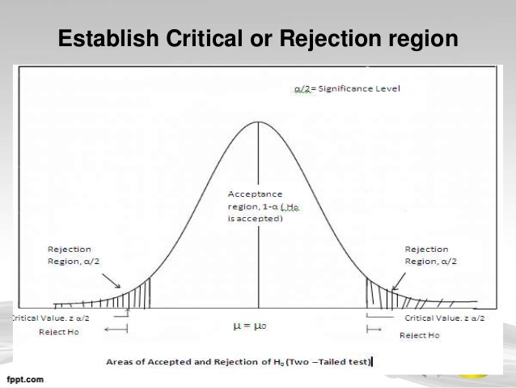
Simple Linear Regression
Tests of Hypotheses
A hypothesis test is a statistical test that is used to determine whether there is enough evidence in a sample of data to infer that a certain condition is true for the entire population.
Null hypothesis (H₀)
The null hypothesis states that a population parameter is equal to a value. The null hypothesis is often an initial claim that researchers specify using previous research or knowledge.
Alternative Hypothesis (H₁)
The alternative hypothesis states that the population parameter is different than the value of the population parameter in the null hypothesis. The alternative hypothesis is what you might believe to be true or hope to prove true.

Slide 14
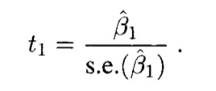
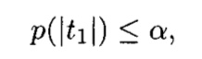
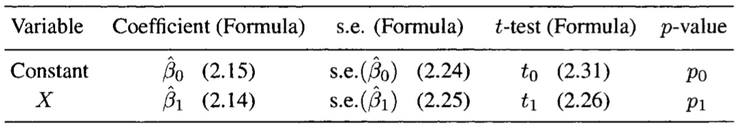
header
Measuring usefulness of X as a predictor of Y
Hypothesis testing about regression parameter β1
Under the normality assumption, an appropriate test statistic for testing the null hypothesis Ho : β1 = 0 against the alternative H1 : β1 ≠0 is the t-test.
The statistic t1 is distributed as a Student’s t with(n- 2) degrees of freedom. The test is carried out by comparing this observed value with the appropriate critical value obtained from the t-table.
The probability that a random variable having a Student t distribution with ( n - 2) is greater than It11 . The p-value is the sum of the two shaded areas under the curve on the edges.

Slide 15
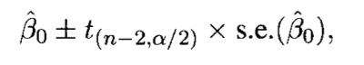
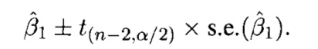
Simple Linear Regression
Confidence Intervals
Describe the amount of uncertainty associated with a sample estimate of a population parameter.
The confidence interval has the usual interpretation, namely, if we were to take repeated samples of the same size at the same values of X and construct for example 95% confidence intervals for the slope parameter for each sample, then 95% of these intervals would be expected to contain the true value of the slope.

Slide 16
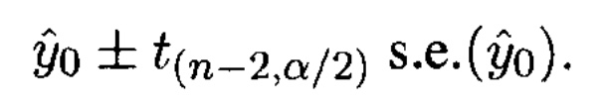
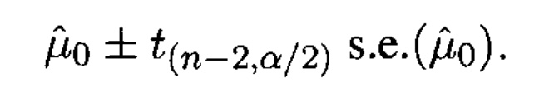
Simple Linear Regression
Prediction of Y for any X
Predictions
The fitted regression equation can be used for prediction. We distinguish between two types of predictions:
Prediction/forecast for any value of X
Confidence limits for mean response
Mean response confidence interval

Slide 17
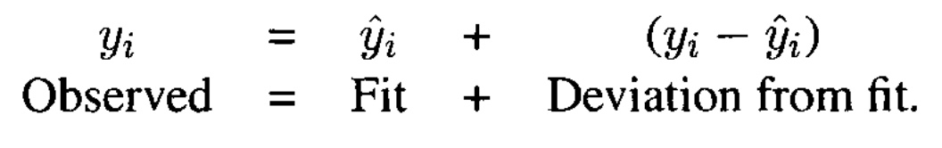
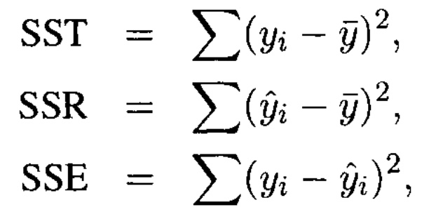
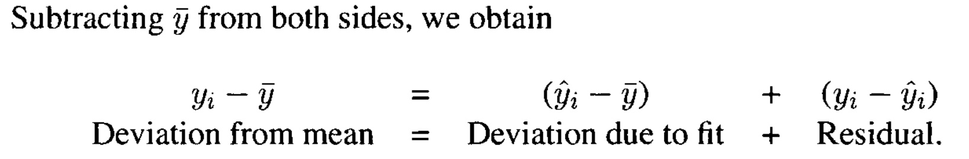
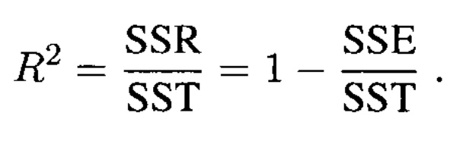
Simple Linear Regression
Quality of Fit measurement
Magnitude of t test – larger the t, smaller is the p value stronger is the relationship between Y and X
Scatter plot between Y and X – this is a subjective approach
Scatter plot between Y and fitted Y – closer the set of points to a straight line, stronger the relationship between Y and X
The goodness-of-fjt index, R2,may be interpreted as the proportion of the total variability in the response variable Y that is accounted for by the predictor variable X .

Slide 18
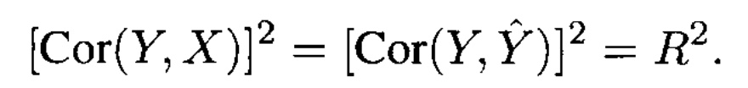
Key things to remember
For the case of simple linear regression

Slide 19
A newspaper owner’s Dilema
Daily circulation: 500,000
To start the Sunday edition or not
Father and son conflict
Father requires minimum guarantee of 600,000 and feels that they cannot handle demand of more than 700,000
Son wants to go ahead even if the minimum guarantee is 570,000 and feels that they can handle the demand up to 730,000

Slide 20
What data?
What data?
Do not have enough time for market survey.
Have to rely on others’ experience

Slide 21
Bivariate Data: The Newspaper Data
In order to investigate the feasibility of starting a Sunday edition for a large metropolitan newspaper, information was obtained from a sample of 34 newspapers concerning their daily and Sunday circulations (in thousands)
The data! (Can be found on: textbook page:54, table 2.12, textbook’s website)
Newspaper | daily | sunday | Newspaper | daily | sunday
Baltimore Sun | 391.952 | 488.506 | New York Daily News | 781.796 | 983.24
Boston Globe | 516.981 | 798.298 | New York Times | 1209.225 | 1762.015
Boston Herald | 355.628 | 235.084 | Newsday | 825.512 | 960.308
Charlotte Observer | 238.555 | 299.451 | Omaha World Herald | 223.748 | 284.611
Chicago Sun Times | 537.78 | 559.093 | Orange County Register | 354.843 | 407.76
Chicago Tribune | 733.775 | 1133.249 | Philadelphia Inquirer | 515.523 | 982.663
Cincinnati Enquirer | 198.832 | 348.744 | Pittsburgh Press | 220.465 | 557
Denver Post | 252.624 | 417.779 | Portland Oregonian | 337.672 | 440.923
Des Moines Register | 206.204 | 344.522 | Providence Journal-Bulletin | 197.12 | 268.06
Hartford Courant | 231.177 | 323.084 | Rochester Democrat & Chronicle | 133.239 | 262.048
Houston Chronicle | 449.755 | 620.752 | Rocky Mountain News | 374.009 | 432.502
Kansas City Star | 288.571 | 423.305 | Sacramento Bee | 273.844 | 338.355
Los Angeles Daily News | 185.736 | 202.614 | San Francisco Chronicle | 570.364 | 704.322
Los Angeles Times | 1164.388 | 1531.527 | St. Louis Post-Dispatch | 391.286 | 585.681
Miami Herald | 444.581 | 553.479 | St. Paul Pioneer Press | 201.86 | 267.781
Minneapolis Star Tribune | 412.871 | 685.975 | Tampa Tribune | 321.626 | 408.343
New Orleans Times-Picayune | 272.28 | 324.241 | Washington Post | 838.902 | 1165.567
Source: Gale Directory of Publications, 1994

Slide 22
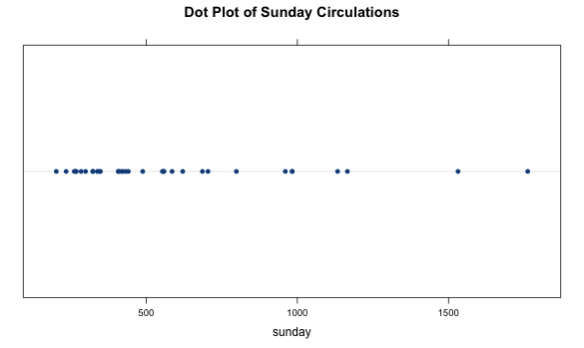
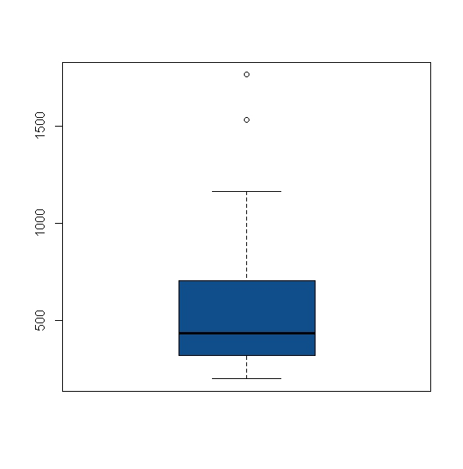
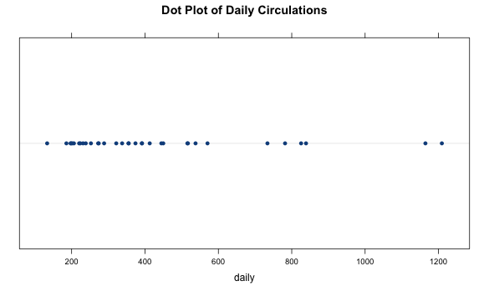

Dot Plot: The Newspaper data

Slide 23
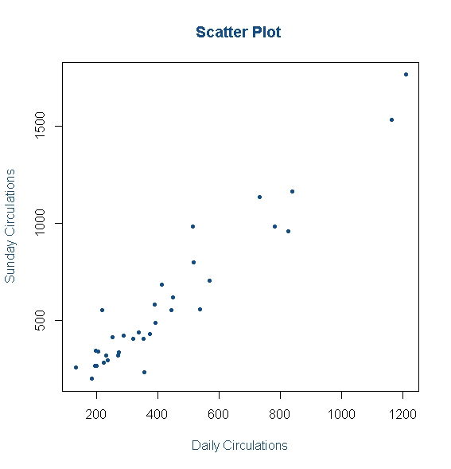
Scatter Plot: The Newspaper data
Textbook Q 2.12 (a)
Construct a scatter plot of Sunday circulation versus daily circulation. Does the plot suggest a linear relationship between daily and Sunday circulation? Do you think this is a plausible relationship?

Slide 24
Quantifying Association
Covariance
Correlation coefficient
Measure of Association/Data | WC-AT Data | Newspaper Data | R-codes
Covariance | 643.39 | 97095.58 | cov(Waist,AT)
 |  |  | cov(sunday, daily)
Correlation coefficient | 0.7656 | 0.9581 | cor(Waist,AT)
 |  |  | cor(sunday, daily)

Slide 25
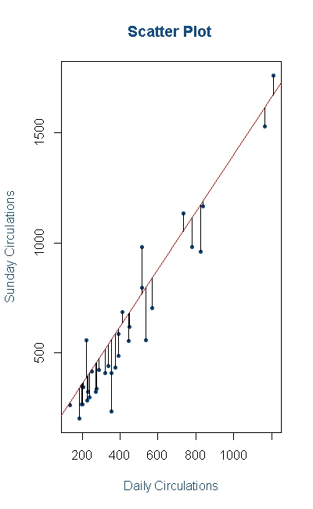
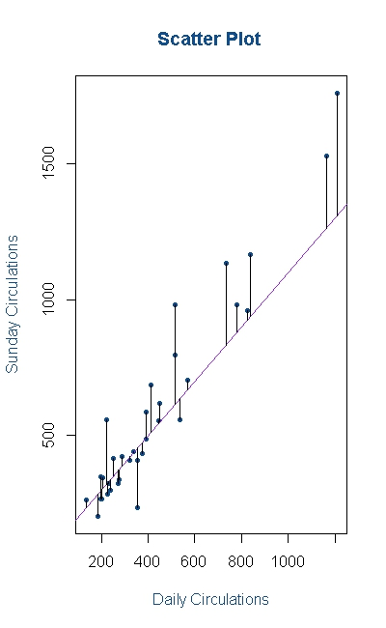
Which Straight Line? The Newspaper data

Slide 26

The Best Line: Least Squares Method
The line of our interest is:
What values of best explain the variation in the data?
Least Squares Method
Fitting a straight line by least squares

Slide 27
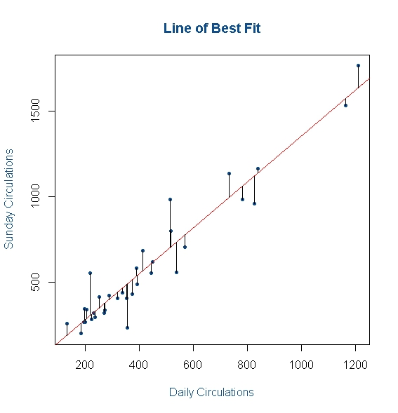
The Best Line: Least Squares Method

Slide 28
Simple Linear Regression: The Newspaper data
Regression Output
Coefficients | Estimate | Std. Error | t value | Pr(>|t|)
(Intercept) | 13.83563 | 35.80401 | 0.386 | 0.702
daily | 1.33971 | 0.07075 | 18.935 | <2e-16 | ***
Signif. codes: 0 '***' 0.001 '**' 0.01 '*' 0.05 '.' 0.1 ' ' 1
Residual standard error: 109.4 on 32 degrees of freedom
Multiple R-squared: 0.9181, Adjusted R-squared: 0.9155
F-statistic: 358.5 on 1 and 32 DF, p-value: < 2.2e-16
Measure of strength of linear relationship, R²
Textbook Q 2.12 (e)
What proportion of the variability in Sunday circulation is accounted for by daily circulation?

Slide 29
Simple Linear Regression: Estimation & Prediction
Confidence interval for the slope
The (1-α)*100% confidence intervals are:
Textbook Q 2.12 (c)
Obtain the 95% confidence intervals for
Estimate | Lower Limit | Estimate | Upper Limit
(intercept) | -59.094743 | 13.83563 | 86.766003
daily | 1.195594 | 1.33971 | 1.483836

Slide 30
Bivariate Data: The Waist Circumference – Adipose Tissue data
A business problem:
The Waist Circumference – Adipose Tissue data
Studies have shown that individuals with excess Adipose tissue (AT) in the abdominal region have a higher risk of cardio-vascular diseases
Computed Tomography, commonly called the CT Scan is the only technique that allows for the precise and reliable measurement of the AT (at any site in the body)
The problems with using the CT scan are:
Many physicians do not have access to this technology
Irradiation of the patient (suppresses the immune system)
Expensive
Is there a simpler yet reasonably accurate way to predict the AT area? i.e.
Easily available
Risk free
Inexpensive
A group of researchers¹ conducted a study with the aim of predicting abdominal AT area using simple anthropometric measurements i.e. measurements on the human body
The Waist Circumference – Adipose Tissue data is a part of this study wherein the aim is to study how well waist circumference(WC) predicts the AT area.
¹ Jean-Pierre Després, Denis Prud’homme, Marie-Christine Pouliot, Angelo Tremblay, and Claude Bouchard

Slide 31
Bivariate Data: The Waist Circumference – Adipose Tissue data
The data! (Can be found in the Datasets folder on LMS, “wc-at.csv”)
Observation | Waist | AT | Observation | Waist | AT | Observation | Waist | AT
1 | 74.75 | 25.72 | 38 | 103 | 129 | 75 | 108 | 217
2 | 72.6 | 25.89 | 39 | 80 | 74.02 | 76 | 100 | 140
3 | 81.8 | 42.6 | 40 | 79 | 55.48 | 77 | 103 | 109
4 | 83.95 | 42.8 | 41 | 83.5 | 73.13 | 78 | 104 | 127
5 | 74.65 | 29.84 | 42 | 76 | 50.5 | 79 | 106 | 112
6 | 71.85 | 21.68 | 43 | 80.5 | 50.88 | 80 | 109 | 192
7 | 80.9 | 29.08 | 44 | 86.5 | 140 | 81 | 103.5 | 132
8 | 83.4 | 32.98 | 45 | 83 | 96.54 | 82 | 110 | 126
9 | 63.5 | 11.44 | 46 | 107.1 | 118 | 83 | 110 | 153
10 | 73.2 | 32.22 | 47 | 94.3 | 107 | 84 | 112 | 158
11 | 71.9 | 28.32 | 48 | 94.5 | 123 | 85 | 108.5 | 183
12 | 75 | 43.86 | 49 | 79.7 | 65.92 | 86 | 104 | 184
13 | 73.1 | 38.21 | 50 | 79.3 | 81.29 | 87 | 111 | 121
14 | 79 | 42.48 | 51 | 89.8 | 111 | 88 | 108.5 | 159
15 | 77 | 30.96 | 52 | 83.8 | 90.73 | 89 | 121 | 245
16 | 68.85 | 55.78 | 53 | 85.2 | 133 | 90 | 109 | 137
17 | 75.95 | 43.78 | 54 | 75.5 | 41.9 | 91 | 97.5 | 165
18 | 74.15 | 33.41 | 55 | 78.4 | 41.71 | 92 | 105.5 | 152
19 | 73.8 | 43.35 | 56 | 78.6 | 58.16 | 93 | 98 | 181
20 | 75.9 | 29.31 | 57 | 87.8 | 88.85 | 94 | 94.5 | 80.95
21 | 76.85 | 36.6 | 58 | 86.3 | 155 | 95 | 97 | 137
22 | 80.9 | 40.25 | 59 | 85.5 | 70.77 | 96 | 105 | 125
23 | 79.9 | 35.43 | 60 | 83.7 | 75.08 | 97 | 106 | 241
24 | 89.2 | 60.09 | 61 | 77.6 | 57.05 | 98 | 99 | 134
25 | 82 | 45.84 | 62 | 84.9 | 99.73 | 99 | 91 | 150
26 | 92 | 70.4 | 63 | 79.8 | 27.96 | 100 | 102.5 | 198
27 | 86.6 | 83.45 | 64 | 108.3 | 123 | 101 | 106 | 151
28 | 80.5 | 84.3 | 65 | 119.6 | 90.41 | 102 | 109.1 | 229
29 | 86 | 78.89 | 66 | 119.9 | 106 | 103 | 115 | 253
30 | 82.5 | 64.75 | 67 | 96.5 | 144 | 104 | 101 | 188
31 | 83.5 | 72.56 | 68 | 105.5 | 121 | 105 | 100.1 | 124
32 | 88.1 | 89.31 | 69 | 105 | 97.13 | 106 | 93.3 | 62.2
33 | 90.8 | 78.94 | 70 | 107 | 166 | 107 | 101.8 | 133
34 | 89.4 | 83.55 | 71 | 107 | 87.99 | 108 | 107.9 | 208
35 | 102 | 127 | 72 | 101 | 154 | 109 | 108.5 | 208
36 | 94.5 | 121 | 73 | 97 | 100
37 | 91 | 107 | 74 | 100 | 123

Slide 32
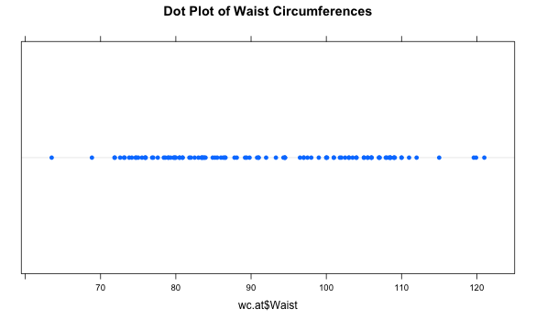
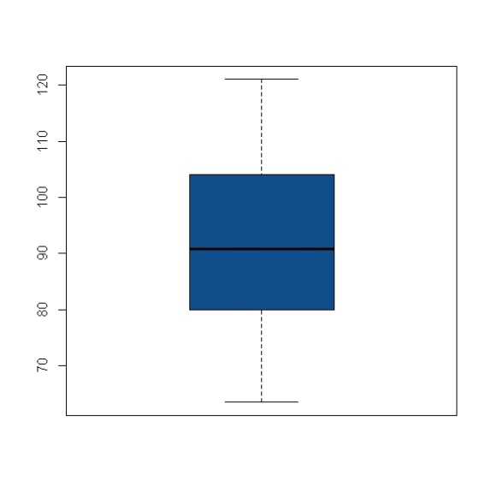
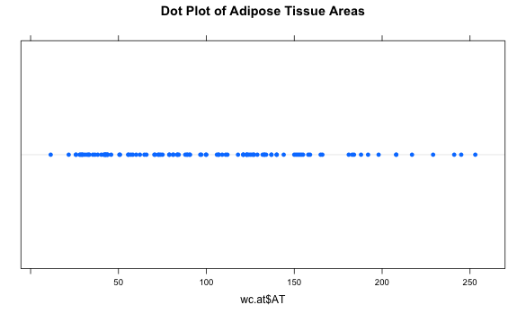
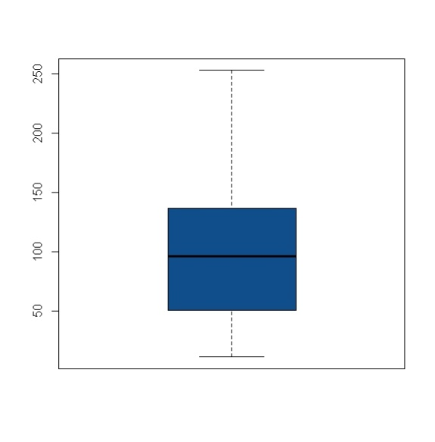
Dot Plot: The Waist Circumference – Adipose Tissue data

Slide 33
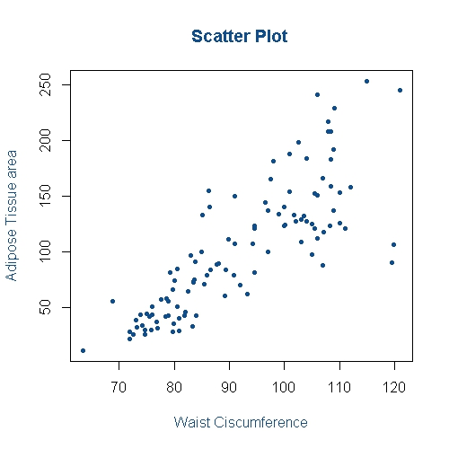
Scatter Plot: The Waist Circumference – Adipose Tissue data
CPQ-1:
Note two observations about this graph

Slide 34
Simple Linear Regression: The AT-WC Data
Regression Output
Coefficients | Estimate | Std. Error | t value | Pr(>|t|)
(Intercept) | -215.9815 | 21.7963 | -9.909 | <2e-16 | ***
Waist | 3.4589 | 0.2347 | 14.740 | <2e-16 | ***
Signif. codes: 0 '***' 0.001 '**' 0.01 '*' 0.05 '.' 0.1 ' ' 1
Residual standard error: 33.06 on 107 degrees of freedom
Multiple R-squared: 0.67, Adjusted R-squared: 0.667
F-statistic: 217.3 on 1 and 107 DF, p-value: < 2.2e-16
CPQ-2:
What if the Waist circumference was Zero or Ten? Does the prediction make sense then?
Notes:
2000000

Slide 35
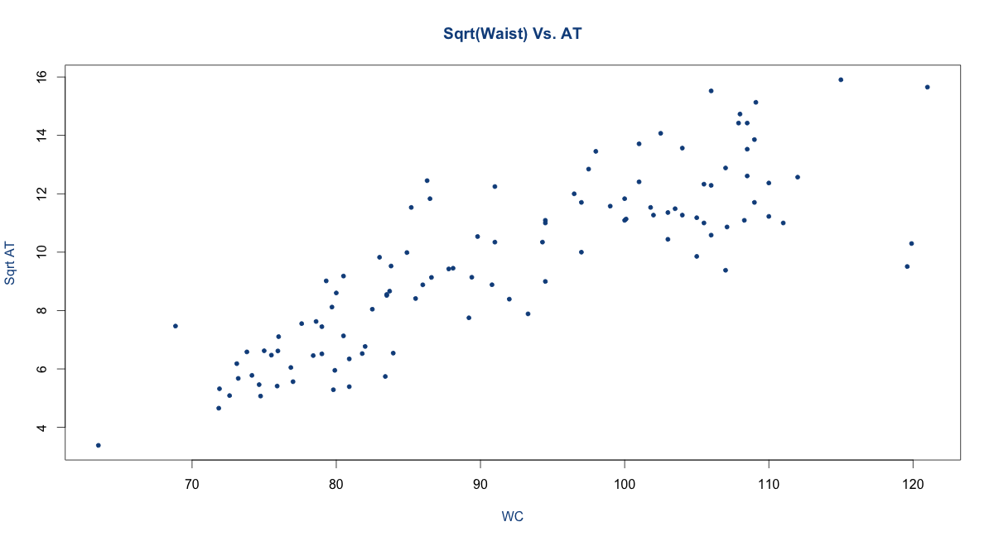
WC vs. Sqrt AT

Slide 36
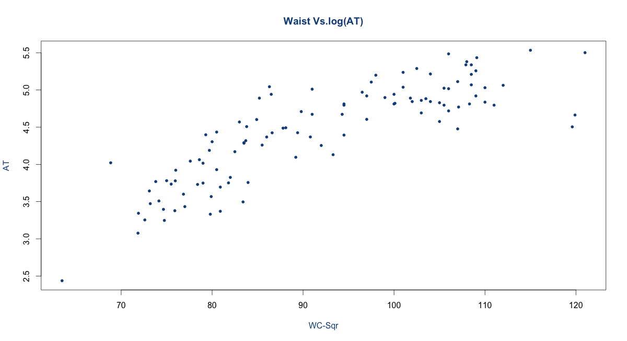
WC vs. log(AT)

Slide 37
The Regressions
sqrt(AT)~Waist
Coefficients: | Estimate | Std. Error | t-value | Pr(>|t|)
(Intercept) | -6.8984 | 1.03576 | -6.66 | 1.22E-09 | ***
Waist | 0.18031 | 0.01115 | 16.17 | < 2e-16 | ***
---
Signif. codes: 0 '***' 0.001 '**' 0.01 '*' 0.05 '.' 0.1 ' ' 1
Residual standard error: 1.571 on 107 degrees of freedom
Multiple R-squared: 0.7096, Adjusted R-squared: 0.7069
F-statistic: 261.5 on 1 and 107 DF, p-value: < 2.2e-16
Log(AT)~Waist
Coefficients: | Estimate | Std. Error | t value | Pr(>|t|)
(Intercept) | 0.741021 | 0.232628 | 3.185 | 0.00189 | **
Waist | 0.040252 | 0.002504 | 16.073 | < 2e-16 | ***
Signif. codes: 0 '***' 0.001 '**' 0.01 '*' 0.05 '.' 0.1 ' ' 1
Residual standard error: 0.3529 on 107 degrees of freedom
Multiple R-squared: 0.7071, Adjusted R-squared: 0.7044
F-statistic: 258.3 on 1 and 107 DF, p-value: < 2.2e-16

Slide 38
Regression
Log(AT)~Waist + Waist^2
Coefficients: | Estimate | Std. Error | t value | Pr(>|t|)
(Intercept) | -7.8240714 | 1.4729616 | -5.312 | 6.03E-07 | ***
Waist | 0.2288644 | 0.0322008 | 7.107 | 1.43E-10 | ***
waist.sqr | -0.0010163 | 0.0001731 | -5.871 | 5.03E-08 | ***
Signif. codes: 0 '***' 0.001 '**' 0.01 '*' 0.05 '.' 0.1 ' ' 1
Residual standard error: 0.308 on 106 degrees of freedom
Multiple R-squared: 0.779, Adjusted R-squared: 0.7748
F-statistic: 186.8 on 2 and 106 DF, p-value: < 2.2e-16

Slide 39
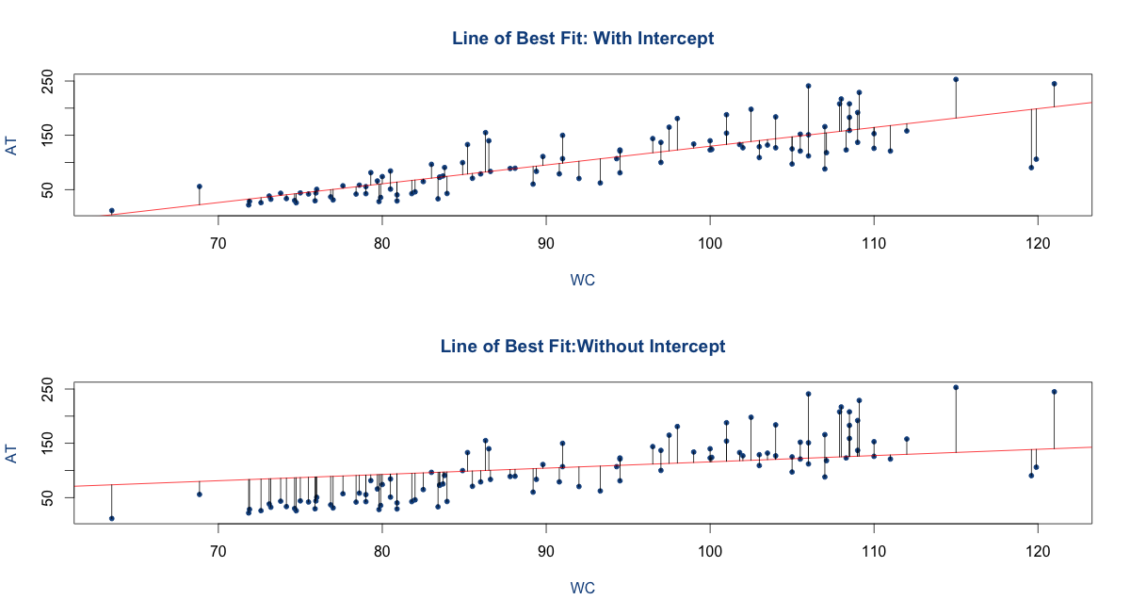
Regression With & without Intercept: The AT-WC Data
R-Sq: 0.67
R-Sq: 0.85

Slide 40
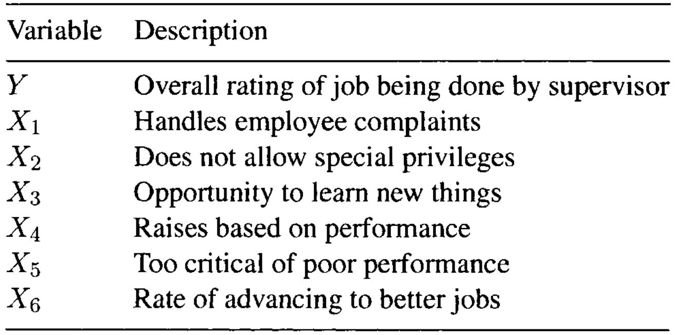
Multiple Linear Regression
What is MLR and how it is different from SLR
Parameter Estimation
Interpretation of Regression Coefficients
Regression coefficients is also called partial regression coefficient because it represents the contribution of corresponding Xi variable to the response Y after it has been adjusted for the other predictor variables

Slide 41
Multiple Linear Regression
Centering
Centered variable is obtained by subtracting from each observation the mean of all observations
Scaling
Unit length scaling
Standardizing
Note – Standardized variables of Y and X have means zero and unit std. deviation. So correlations are not affected by centering/scaling

Slide 42
Multiple Linear Regression
Multiple Correlation coefficient = √R-square
Adjusted R-square is metric tries to adjust for the unequal number of variables in different models

Slide 43
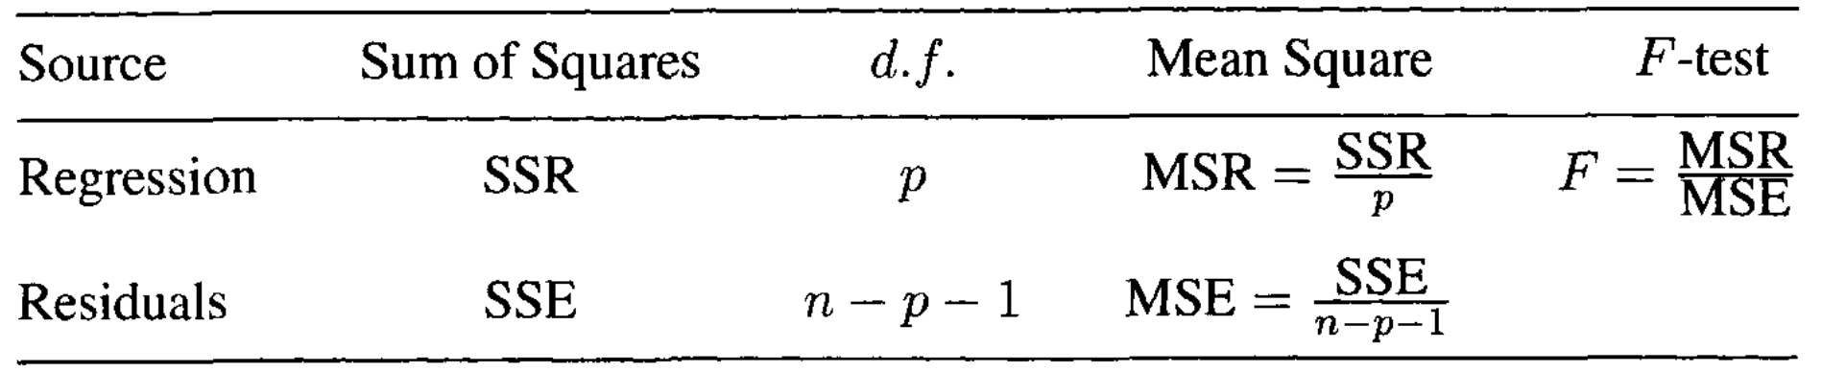
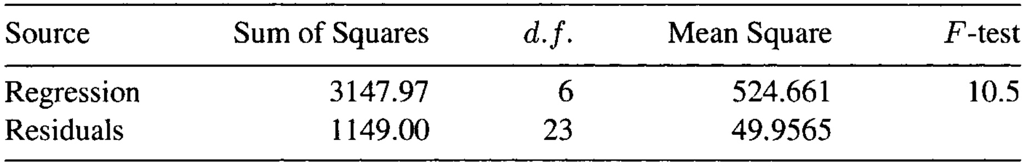
Multiple Linear Regression
Tests of Hypothesis in a Linear Model
All the regression coefficients associated with the predictor variables are zero
Some of the regression coefficients are zero
Some of the regression coefficients are equal to each other
The regression parameters satisfy certain specified constraints
F-Test can be used for testing all the hypothesis
Note - A particular case is when none of the t-values for testing the regression coefficients are significant, but the F-test is significant. This implies that although none of the variables individually have have significant explanatory power, entire set of variables taken together explain a significant part of the variation in the dependent variable. This is related to multicollinearity which we will discuss later. For further details refer (http://www.statisticshowto.com/f-statistic/)
F = variation between sample means / variation within the samples

Slide 44
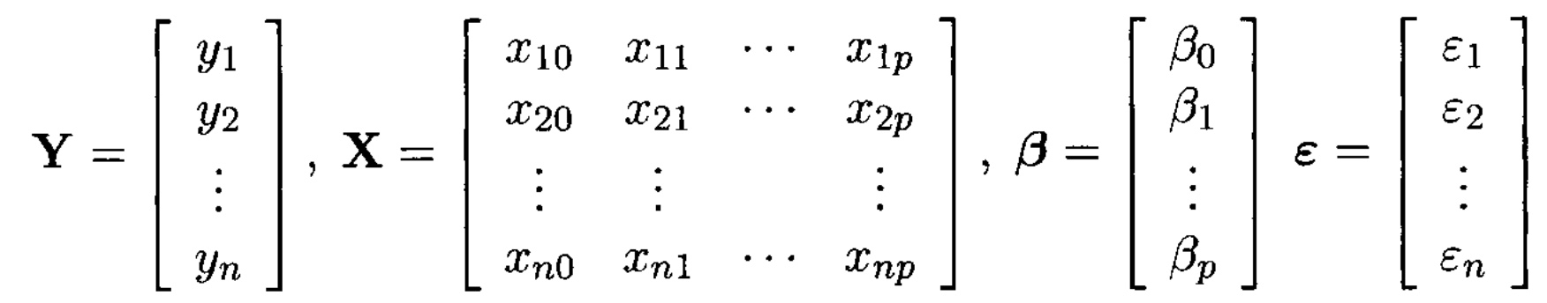
Multiple Linear Regression
Matrix Notation

Slide 45
Regression Assumptions (Diagnostics(http://www.statmethods.net/stats/rdiagnostics.html)
Assumptions about the form of the model - Linearity
Assumptions about the errors – Normality of the residuals
Assumptions about the predictors - Multicollinearity
Non-constant Error Variance – Homoscedasticity
Outliers
Influential observations
Non-independence of Errors - Autocorrelation

Slide 46
Homoscedasticity

Slide 47
Homoscedasticity

Slide 48
Homoscedasticity

Slide 49
outliers

Slide 50
Graphs before fitting a model
1-D graphs
Histogram
Stem and Leaf Display
Dotplot
Boxplot
2-D graphs
Draftsman’s plot or plot matrix

Slide 51
Graphs after fitting a model
Linearity and Normality assumptions
Normal Probability plot of the standardized residuals
Scatter plot of standardized residuals against each of the predictor variables
Scatter Plot of the standardized residual versus the fitted values
Index Plot of the standardized residuals
Outlier and Influential observations
Cook’s distance
Welsch and Kuh Measure
Hadi’s Influence Measure
Potential residual plot(related to leverage-residual plot)
Diagnostic plots for the effect of variables
Added variable plot
Residual plus component plot

Slide 52
Qualitative variables as predictors

Slide 53
Variables Transformation

Slide 54
Autocorrelation
Durbin Watson Statistic

Slide 55
Autocorrelation

Slide 56
Multi-collinearity
Detection
VIF
Principal components regression
Ridge regression

Slide 57
Model evaluation
Residual Mean square
Mallows Cp
Information Criteria (AIC,BIC)

Slide 58
Variable Selection procedures
Forward selection Procedure
Backward Elimination Procedure
Stepwise method
Stepwise regression presents you with a single model constructed using the p-values of the predictor variables
Best subsets regression assess all possible models and displays a subset along with their adjusted R-squared and Mallows' Cp values

Slide 59
Sampling procedures for model validation
Bootstrap
Jacknife
Cross validation

Slide 60
Summarize fitting regression models
Examine variables and variable transformations
Scatter plots to examine correlation/collinearity
Fit the full regression model
Linearity assumptions
Heteroscedasticity/Autocorrelation(particularly for time series data)
Outliers/high leverage points/influential points
Examine added variable plots, AIC/BIC criteria if new variables are added
Check VIF/residual plots and repeat above step
Validate model fit by resampling(bootstrap,jacknife,cross validation)

